Slide 1
CS4499/5599: Data Science and Applied Machine Learning
Class Lecture: March 6th, 2023

Slide 2
Objectives
Last time:
Introduced the sklearn package
Data preprocessing
Feature scaling
Today:
Finish Feature Scaling
Splitting Data
Selecting and Fine Tunning Models

Slide 3
Normalization
Another common statistical approach for scaling data is normalization
Normalization is the process of dividing a vector (i.e., our feature) by its length to get a value between 0 and 1
Normalization works best when the data contains few, or no outliers and the data does not follow a Gaussian (normal) distribution
Normalization has a tendency to work better with machine learning techniques that do not assume any type of distribution with the data (neural networks, k-nearest neighbors)

Slide 4
Normalization
Sklearn can perform normalization using three methods L1, L2 and max (L∞)
L1 is the sum of the regularization weights while L2 is the sum of the squares of the regularization weight
L1 is typically more robust and less efficient than L2
L2 while less robust, will always be more efficient than L1
L1 and L2 are often referred to as least absolute deviations and least squares error, respectively
Note that normalization works with the columns not the rows

Slide 5

Normalization
The basic form of normalization
$$x_{normalized}=\frac{x_{i}}{x_{Z}}$$
$${L1:x}_{z}=\sum{\left|x_{i}\right|}$$
$${L2:x}_{z}= \sqrt{\sum{x_{i }^{2}}}$$

Slide 6
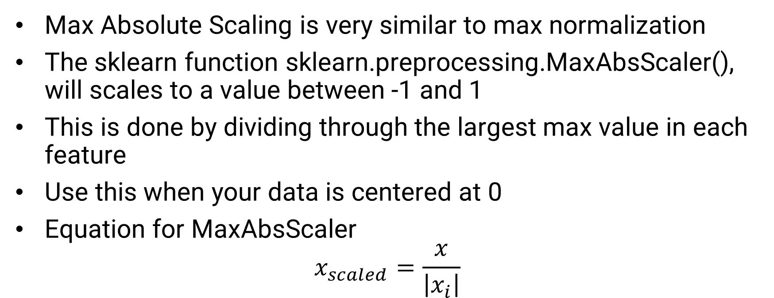
Max Absolute Scaling
Max Absolute Scaling is very similar to max normalization
The sklearn function sklearn.preprocessing.MaxAbsScaler(), will scales to a value between -1 and 1
This is done by dividing through the largest max value in each feature
Use this when your data is centered at 0
Equation for MaxAbsScaler
$$x_{scaled}=\frac{x}{\left|x_{i}\right|}$$

Slide 7
Binary Scaling
In data science there are a number of situations where you will want to deal only with binary values
For example, the Bernoulli Naive Bayes machine learning technique only works with data in a Bernoulli distribution (i.e. binary)
This is also very handy for working with pixels in image data
Sklearn’s Binarizer function will the data into a binary form by converting values that reach a certain threshold to 1 and those that do not to 0
The default threshold is 0, but the user can adjust as needed

Slide 8
Developing Machine Learning Models
Please note you may have to come back (many times) to Step 5-9 depending on your results
Step 6 Split your data for testing/training
Once you are satisfied that your data is ready you need to split your dataset into a training set and a testing set
The purpose of the training data is both teach our model about the data and to validate the initial results
The testing data allows use to evaluate our model's performance on data that was NOT used in training

Slide 9
Splitting the Dataset
A key when preparing the testing data is to ensure the data is selected randomly
By doing this we ensure there is no bias in the testing data and can ensure the testing occurs in as many scenarios as possible
Bias in the selection can result in a misleading models and/or test/training sets that are heavily imbalanced
Ideally, we will do this pseudo-randomly, that way we can repeat training/testing using the same data

Slide 10
Splitting the Dataset
Sklearn has a great function that makes this process easy train_test_split()
This function allows you to specify a dataset and divide it to the degree you want.
It is also handy to split off your target data from the rest of your features as well
The split is done pseudo-randomly but, if necessary, you can change the random_state when you call the function

Slide 11
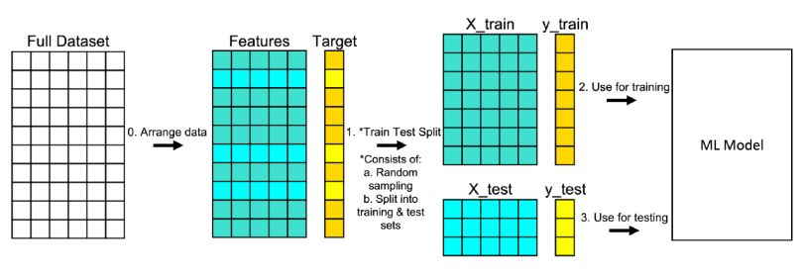
Splitting the Dataset
Overview of the Splitting Process
Sources: Michael Galarnyk

Slide 12
Splitting the Dataset
These leaves the question “How much data should I use for training and how much for testing?”
This is an age all question in machine learning, the easy answer is enough
If you train on too little data, you may find your model comes out underfit
If you train on too much you may find your model overfit
As a data scientist you may have to try different splits to find one that works

Slide 13
Cross Validation
When we split our data, there is another question we need to consider, “Is it possible we just got lucky with our split?”
We can address this using a method called cross validation
Cross validation is a resampling technique, that will take a divide the testing data into smaller subsets known as folds
One of the folds is held out for validation, the model is then trained on the remaining folds
The results are saved, and the process is repeated with a different fold held for validation
The process is repeated for each fold

Slide 14
Cross Validation
Once all the folds have been used for validation the results from all the testing is averaged
As has been the case with other machine learning concepts, there is no set rule for the number of folds to use, 5 or 10 is most common
Sklearn has a cross_val_score that will let you perform this with your model and data after testing
Benefits of cross validation include better use of data and can help address model overfit
For right now you are not required to make use of cross validation on your assignments

Slide 15

Cross Validation

Slide 16
Model Selection
Step 7 Choose a model to train using your data
Once your data is properly split, you have everything you need to train a machine learning model
You should already know if you will be using regression or classification depending on what you want to predict
However, as you will soon discover there are several different approaches for both types of models
Our focus for the rest of the semester will be going over many of the different non-neural network techniques using sklearn

Slide 17
Model Selection
A common question in data science is “How do I know which model is the best to use”
The answer is you won’t know which is best until you test them all!
Having a variety of models to choose from will help your cause when you defend your work
The key with machine learning model is not just to develop the “best” model, but to develop one that does the job you intended to do
The criteria will depend on the project you are working on (and the people who are funding the project)

Slide 18
Model Testing
Step 8 Evaluate your model
Once you have trained a model, you will use your testing set to how your model performs with “new” data
You will also want to test your model with the data you used to train the model, this is referred to as model validation
Once you have testing and validation results you can compare the two to see if you are overfit or underfit
Overfit models will have a validation results that are better than the testing results while the inverse is true for underfit

Slide 19
Model Overfit
Model overfit is very common in machine learning, especially with supervised learning
The degree to which you model can be overfit depends solely on the requirements of your project
It is possible that an overfit model could do the job you intend it to do, but in most cases, you will want to address overfit
That said if you have a small amount model overfit it generally is okay (usually it is expected)
Ex: If we have a classification model with a validation accuracy of 91% and testing accuracy of 93%, many applications will find this acceptable

Slide 20
Fine Tunning Models
Step 9 Fine Tune Your Model
Its at this point you will need to decide if performance meets your goals and expectations
If it does you can begin the process of saving, defending and deploying your model, but keep in mind you will likely have to come back and adjust at some point anyway
If the model didn’t meet your goals, you will need to go back and make changes, until you find a combination that produced results that are acceptable

Slide 21
Fine Tunning Models
Here are some suggestions you can try to train better performing models if you first attempt didn’t work out
Model Overfitted
Reduce the number of features in your model (Dimensionality)
Increase the amount of training data (samples)
Use Cross Validation
Add some noise to your data
Model Underfit/Model Tests Poorly
Try different hyper parameters (more on this soon)
Increase the amount of data used in training
Try different feature preprocessing techniques
Try different machine learning techniques

Slide 22
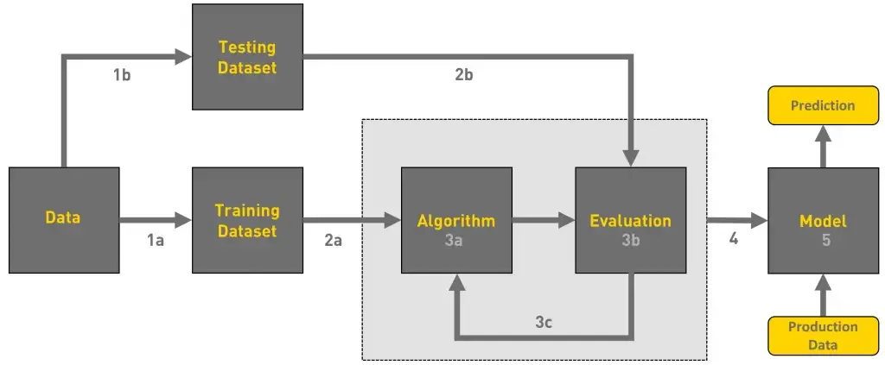
Complete Machine Learning Process
Source: Ayush Pant

Slide 23
Complete Machine Learning Process
Step 1 Frame the Problem
Step 2 Find Data
Step 3 List and check any assumptions
Step 4 Explore the Dataset
Step 5 Data Preparation & Preprocessing
Step 6 Split your data for testing/training
Step 7 Choose a model to train using your data
Step 8 Evaluate your model
Step 9 Fine Tune Your Model

Slide 24
Next Time
Being to train ML models using regression
Training Linear Regression Models using sklearn
Evaluating regression models using sklearn
Hyperparameters and Hyperparameter Tunning
Polynomial, Ridge and Lasso Regression
Expect Homework 6 on Wednesday 3/8

